Slide 1
Safe Families and
Home for Good

Slide 3
Welcome and Community is God’s business
John 1:14 The Word became flesh and blood and moved into the neighbourhood.
Zacchaeus – Luke 19
Healing in the Gerasenes – Mark 5

Slide 4
Welcome and Community is our business
If our worship of God doesn’t affect our actions, we’ve probably missed the point.

Slide 6
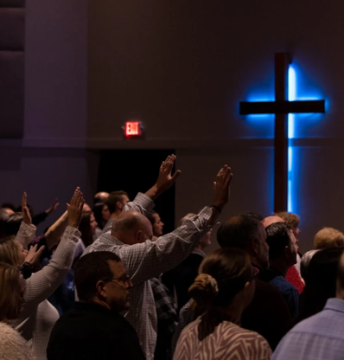
Why Should this matter to us the church?
We Are Called
We Are Present
We Are Community

Slide 7
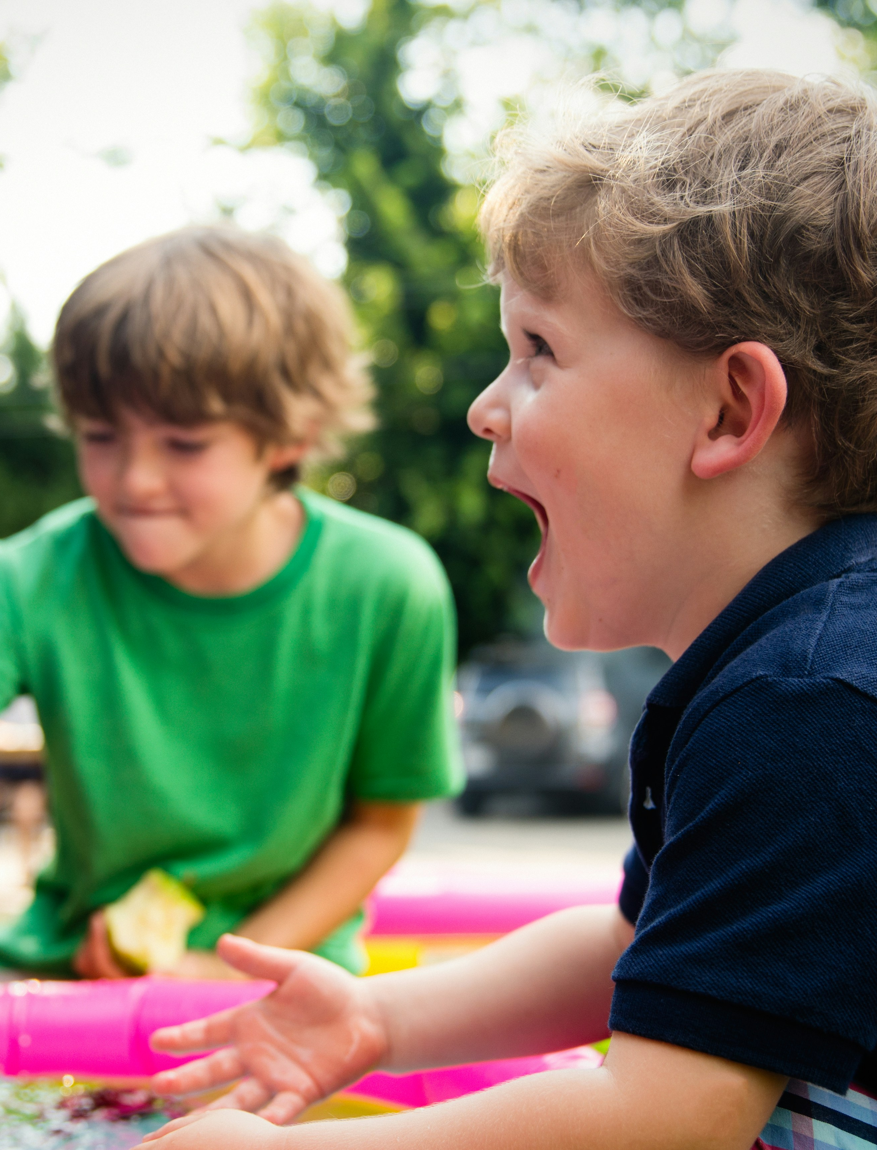
Sadie’s Story
What would you do?

Slide 9
Sadie’s Story
Social Services closed the case, “no intervention required.”

